Slide 1
What: is Notary v2
Registry-native
Signatures and artifacts co-located for easier and secure management
Secure
Attesting to its authenticity and/or certification
No trust on first use, no implicit permissions on rotated keys, secure private keys and PKI
Portable
Artifacts move within and across registries supporting provenance, validation and trust
Multi-tenant
Enable cloud providers and enterprises to easily support managed services at scale
Offline & Air-gapped
Artifacts can be signed offline
Artifacts and signatures can be moved into air-gapped environments
Usable
Simple commands to integrate with toolchains, supporting key hierarchies
Notary v1 does not meet these requirements Notary v2 intends to

Slide 2
Notary v2 Requirements
Offline signing
Must not change the tag or digest, just to be signed
Cross cloud, on-prem and air-gapped adoption
Ephemeral clients
Multiple signatures
Enabling originating vendor, aggregator certification, customer validation
Keys secured by cloud providers key vault offering (pluggable)
Key acquisition: from hobbyist, open source projects, to large
software vendors

Slide 3
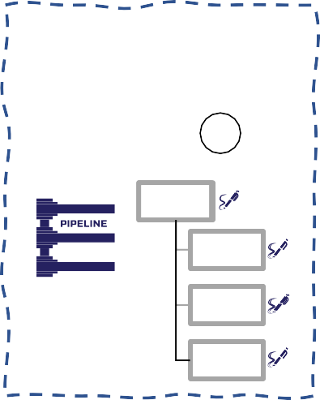


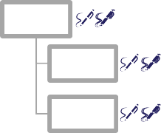



Notary v2 Workflow
Wabbit Networks
Docker Hub
ACME Rockets
Artifact Build Environment
Index
5
1
2
3
Public
Registry
Index
Private
Registry
Image
Image
Image
4
Container Host
SBoM
SBoM
src
src
Policy Management
deploy
An entity authors content
signs their content with their key
Publish to a well-known location
Notary v2 Scope
Interoperability with other projects
May get certified by the aggregator
Consume the public content into an entity's private registry
Add a verification signature, attesting to its usage in the company
Policy management enforces which keys can be used for deployment, even what registries content can be pulled from
Only after all signatures and policies are verified can the artifact be deployed

Slide 4
Prototyping Approach
How to build complex systems?
How do we establish a model for communication?
We want to build a house?
What does that mean?
What style?
How many rooms?
City, Suburb, Mountain, Beach?
What style of kitchen?
What style of bathroom?
Enlisting expertise of the trades
Grading contractors
Foundation contractors
Framing contractors
HVAC contractors
Plumbing contractors
Electrical contractors
tub
tub

Slide 5
Where are we now?
Prototyping to get closer to where we want to be
Prototype 1
Generic signing of content
Supporting any content pushed to an OCI Artifacts enabled registry
Attesting to its authenticity and/or certification
Content copying, with signatures
within and across registries
Into air-gapped environments
Looking at the key management issues, types of keys
Registry persistence and retrieval
An artifact?
Different permissions?
Further prototypes and design decisions
TUF
Rollback protection in a registry context
ephemeral clients and their issues

Slide 6



Breaking down the pieces
5
Registry
OCI Artifact enabled
OCI distribution-spec compliant
2
3
Artifact
Signature
1
4
nv2 client
ORAS client

Slide 7
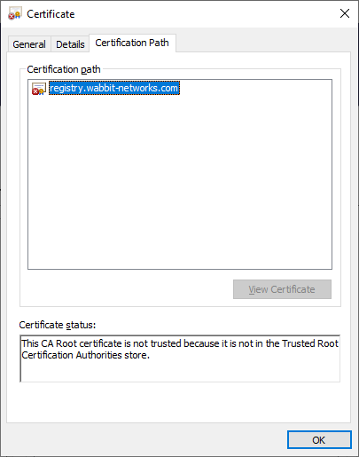
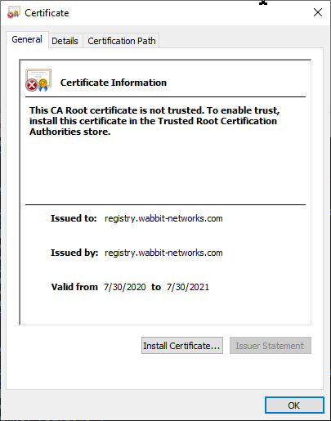
Key – x509
Generate an x509 Cert
Subject CN = originating/vendor registry
openssl req \
-x509 \
-sha256 \
-nodes \
-newkey rsa:2048 \
-days 365 \
-subj "/CN=registry.wabbit-networks.com" \
-keyout wabbit-netowrks.key \
-out wabbit-netowrks.crt

Slide 8
nv2 cli
docker build \
-t registry.wabbit-networks.com/net-monitor:v1 \
.
docker generate manifest \
registry.wabbit-networks.com/net-monitor:v1 > net-monitor_v1-manifest.json
nv2 sign --method x509 \
-k wabbit-networks.key \
-r registry.wabbit-networks.com/net-monitor:v1 \
-o net-monitor.signature.json \
file:net-monitor_v1-manifest.json

Slide 9
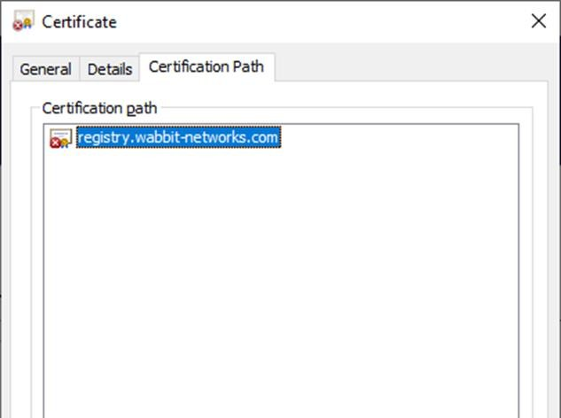
Signature
net-monitor.signature.json
{
"signed": {
"exp": 1626938793,
"nbf": 1595402793,
"iat": 1595402793,
Cert References
OCI Descriptor
"mediaType": "application/vnd.oci.image.manifest.v1+json",
"digest": "sha256:3351c53952446db17d21b86cfe5829ae70f823aff5d410fbf09dff820a39ab55", "size": 528,
"references": [
"registry.wabbit-networks.com/net-monitor:latest", "registry.wabbit-networks.com/net-monitor :v1"
]
},

Slide 10
Signature
net-monitor.signature.json
{
"signed": {
"exp": 1626938793,
"nbf": 1595402793,
"iat": 1595402793,
"mediaType": "application/vnd.oci.image.manifest.v1+json",
"digest": "sha256:3351c53952446db17d21b86cfe5829ae70f823aff5d410fbf09dff820a39ab55", "size": 528,
"references": [
"registry.wabbit-networks.com/net-monitor:latest", "registry.wabbit-networks.com/net-monitor :v1"
]
} ,
"signature": { "typ": "x509",
"sig": "uFKaCyQ4MtVHemfLVq5gYZyeiClS20tksXzP7hhpeqqjCNK9DiHnoDpkq91sutLqd1o6RCxpfFVuGXy20oqRu1/ZoXXAVC3y7lS6z/wqJ4VDB
KSj/H6xyYn7pH3GE8GHR6kjFPqrGsl/OS4yYH2oNXEm9W8Pju2wC381+FCgf4LNf7k6u2Uf4Fb0/Fl40qzvr0m2Fv5pXtRY+wdJctqJb+t408VcXJkNj0U7xoOe0zU r3l1A6xLYqjd0ZY08JBQ8FQul0Vpxrmg0Xdtwd/wEolvia48lxD1x7yphW5bFvJOTd62rOJgd4uI7jYJF3ZLmwjY+geMk5e6Wkp5OyXGjXw==",
"alg": "RS256", "x5c": [
"MIIDmzCCAoOgAw IBAgIUFSzsIT 4/pKtGzywuZWWE7ydi LBIwDQYJKoZIhvcNAQELBQAw XTELMAkGA1UEBhMCQVUxEzARBgNVBAgMClNvbWUtU3 RhdGUx ITAfBg NV BAoMGEludGVybmV0 IFdpZGdpdHMg UHR5IEx0ZDEWMB
QGA1UEAww NKi5le GFtcGxlLmNvb TAeFw0 yMDA3MjIwMzA 2MTBaFw0yMTA 3MjIwMzA2MTBaMF0xCzAJBgNVBAYTAkFVMRMwEQYDVQQIDAp Tb21lLVN0YXRlMSEwHwYDVQQKDBhJbnRlcm5 ldCBXa WRnaXRzIFB0e SBMdGQxFjAUBgNVBAMMD
SouZXhhbXBsZS5jb20wgg EiMA0GCSqGSIb3DQEBAQUAA4 IBDwAwggEKAo IBAQDM 0MNLy/ f1SyRM 0ZQu3AtJnCU3 O5x8nn OeV1my SmZNr2 SCqR8+ jENAoKE5FrrSi2ffMn FPP/7DqGnbb9 +b1nD9 ucFNsI 1iW7Ir F/GlqOM7jJhUMNnOyatz
8mddtQgXr 3SZ9bigbc/lxuVGacvi64DewoWzMFr 4ZMGq8 ik7aDn HryUDw XJFE+KGNbsRe O1ePqKmPiLvk LG4sBTqeTuCk+Grrr5 t1COujwuFWfh MjmRfq 34QGqUZ3SHJYXPzOAxgV3fCm BP9IgHuSv/b1 udx5Htf1BV7WlARtXf E216…"
]
}
}

Slide 11
Persisted as an OCI Artifact
"config.mediaType": "application/vnd.cncf.notary.config.v2+json"
oras push registry.wabbit-networks.com/net-monitor:v1 \
--manifest-config net-monitor.signature.json:application/vnd.cncf.notary.config.v2+json
OCI Manifest
{
"schemaVersion": 2, "config": {
"mediaType": "application/vnd.cncf.notary.config.v2+json",
"digest": "sha256:c7848182f2c817415f0de63206f9e4220012cbb0bdb750c2ecf8020350239814", "size": 1906
},
"layers": []
}

Slide 12
Key management
Key management working group is meeting on Fridays
The prototype we just talked about uses x509
However, x509 keys are not currently widely accessible outside large organizations
Unlike for TLS there is less infra for keys, you can't use Letsencrypt keys for signing
Gives a binding between org name and signature
Can we get that via other means effectively?
Some people want to use GPG
Outside Debian, the web of trust is mostly dead
Covid ends that model? Never realistically worked
Ad hoc keys most likely, as used by TUF
You need to define how you choose to trust keys
Definitely not Notary v1 TOFU
This requires configuration and work from users, so we need to make this extremely easy
Definitely want to be able to manage keys with existing tools
Cloud key stores, Vault, Parsec, Yubikeys

Slide 13
Prototype Roadmap
Mapping TUF into OCI registry types
The canonical TUF design is for a set of files in a filesystem
The OCI registry objects have a slightly different design
For example an OCI descriptor includes a mime type
If we use external signature objects (not inline as in TUF) this changes the layout a little too
This is all fine so long as it is exactly equivalent to preserve security properties
The are several options to explore here, the main constraint is that registries tends to use OCI manifests for garbage collection control
Once we have a representation, there are still more design decisions
Scope of TUF repository: registry, org or repo?
Notary v1 chose repo, which was a bad design
The TUF team believe that registry is the right scope
Some of the registry operators think that is too large
Affects key delegations and root of trust

Slide 14
More design work
Ongoing discussion about rollback protection
Ephemeral machines don't have a history of the repository state, so if an
attacker deletes history they won't notice
Potential solution is to regularly update client base images with the repository state; the most generic solution but also requires work
Another solution is to use transparency logs as a public record of the state of the world; there is a difficulty though in that these are easiest to use with public data, and they are additional infrastructure that needs to be maintained outside the registry
Ephemeral infrastructure has huge advantages, but it does impact security so we need to think about the consequences

Slide 15
Issues about use of registry
The Update Framework is concerned with updates...
We don't have a good exposure of what updates are in a registry
We do not tend to delete much content as it is also an archival record, and we want to support rollbacks and clients that have not yet updated
So a repository will have a lot of tags in...
There are currently 386 tags for Ubuntu in Docker Hub...
14.04, 16.04, 18.04, 20.04 and 20.10 and what those point to are current
But we discourage use of latest and generic tags, and many people want immutable tags
This means additional information is needed to understand what an update is, eg semver, or external tooling which describes the versioning
I think we made some design mistakes here, but rectifying will be difficult

